Slide 1
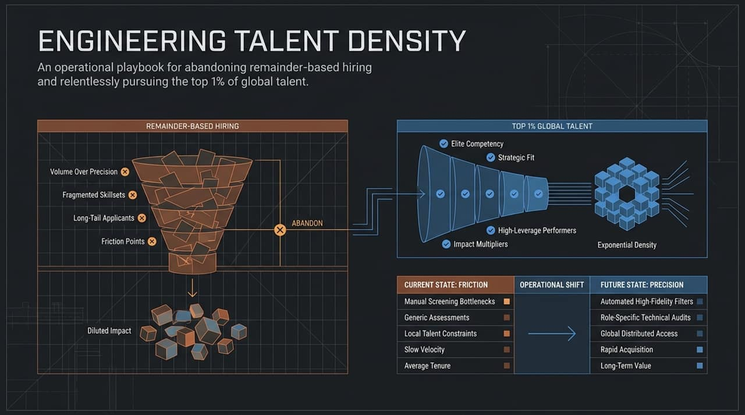
Notes:
Opening: Good morning/afternoon, everyone. Today, we are discussing a fundamental shift in how we approach hiring technical talent. Most hiring strategies rely on what we call "remainder-based hiring"—filling seats with whoever happens to survive an imperfect filtering process.
The Current Reality (Left Side): Right now, conventional hiring acts like a wide funnel driven by volume over precision. We pull in long-tail applicants with fragmented skill sets, push them through various friction points, and end up with diluted impact—hiring average candidates simply because they were the last ones standing.
The Paradigm Shift (Right Side): Instead of treating candidates as generic inputs, we need to treat talent acquisition as an engineering problem. By replacing current-state friction—like manual screening bottlenecks and generic assessments—with future-state precision, we shift toward target-driven global talent access.
Key Takeaway: We are moving away from hiring out of necessity or speed to actively engineering high density, targeting the top 1% of global talent through precision alignment.
https://www.youtube.com/watch?v=zegYJ6dhIg4

Slide 2
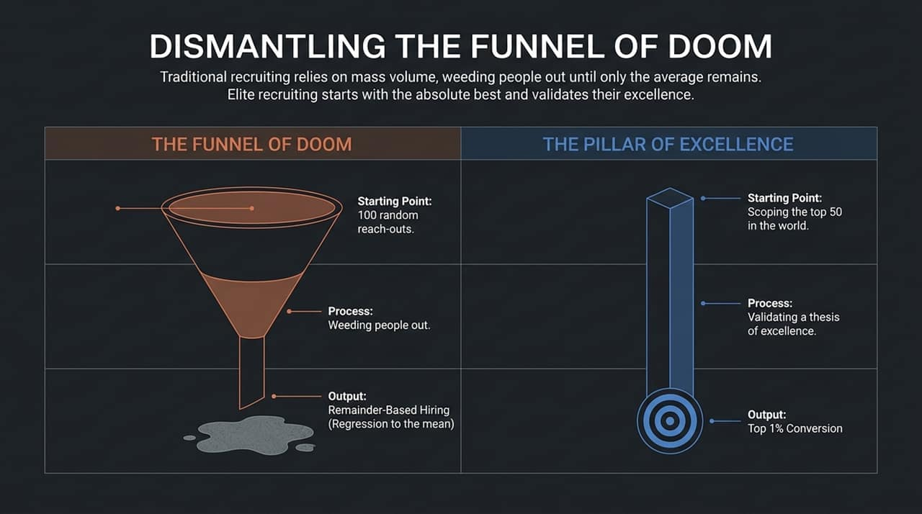
Notes:
The Core Problem: Traditional recruiting relies on the "Funnel of Doom." You start by reaching out to 100 random people, put them through a process designed to weed people out, and what comes out at the bottom? Remainder-based hiring, which leads straight to regression to the mean.
The Alternative — Pillar of Excellence: Elite recruiting flips this dynamic completely. Instead of filtering down a broad, low-quality pool, we start with precision. We scope the top 50 candidates in the world for a given role before we even make contact.
Process Differences: Our process shifts from "weeding out" to validating a thesis of excellence. We know why they are exceptional; our job is to confirm that thesis and align mutual goals.
Key Takeaway: The result of this shift is a direct pipeline to top 1% talent conversion without wasting bandwidth on low-signal candidates.

Slide 3
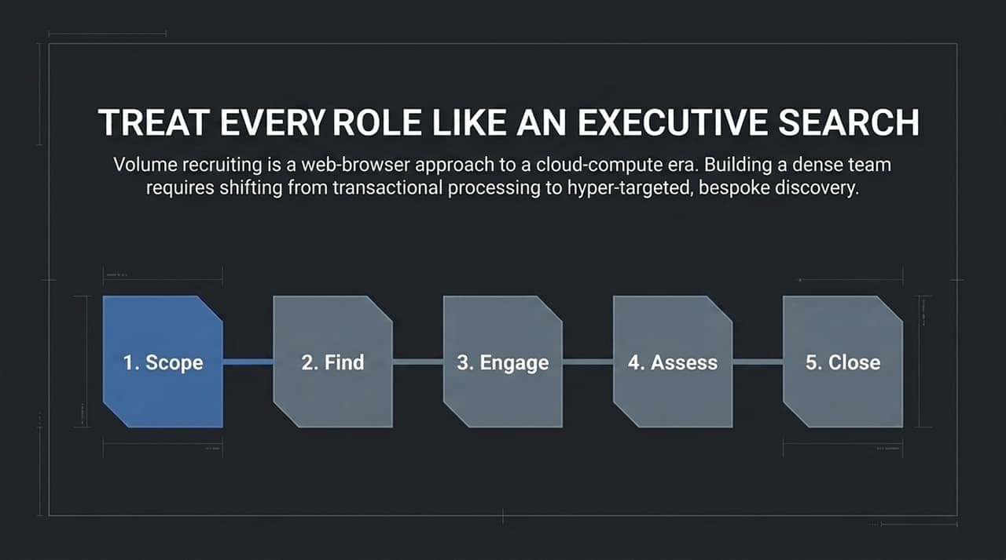
Notes:
The Premise: Volume recruiting is a web-browser approach to a cloud-compute era. If you want to build a dense engineering team, you must treat every single engineering position with the rigor typically reserved for executive-level searches.
The 5-Step Process:
Scope: Precisely define the exact capabilities required.
Find: Target specific individuals across global networks.
Engage: Initiate high-touch, hyper-personalized outreach.
Assess: Conduct rigorous, mutual evaluations.
Close: Execute bespoke closing strategies tailored to individual motivations.
Key Takeaway: When every position is sourced like a C-suite hire, talent density scales naturally across the entire organization.

Slide 4
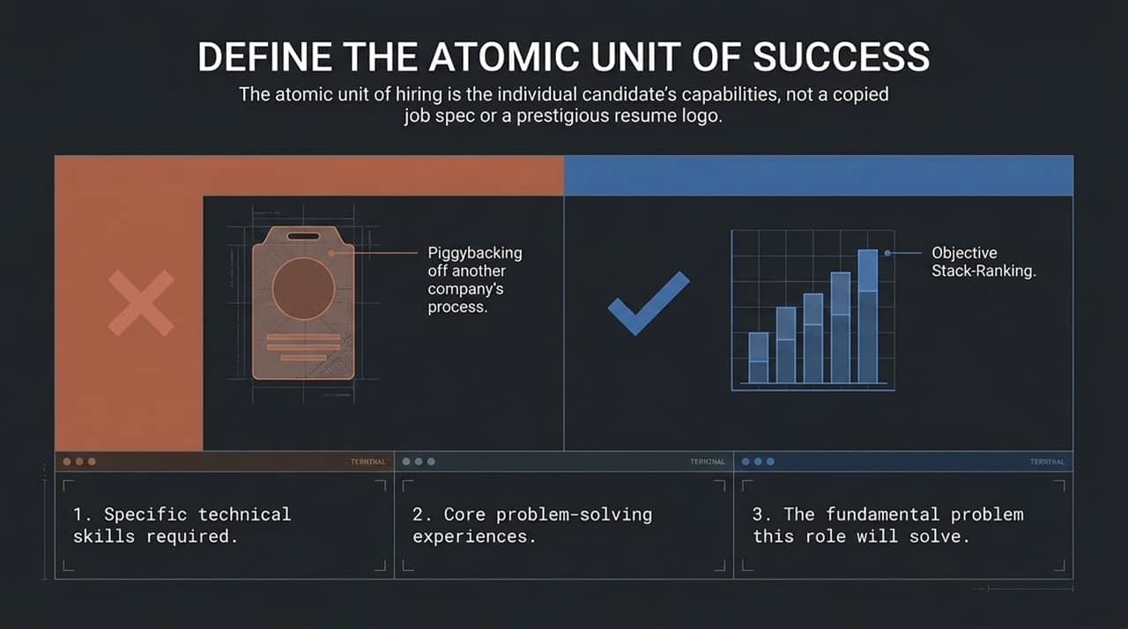
Notes:
Breaking the Habit: Many companies rely on copying job descriptions from tech giants or filtering candidates based on prestigious resume logos. This is piggybacking on another company’s hiring process—and it fails to measure true capability.
The Atomic Unit: The fundamental unit of hiring must be the individual candidate's actual capabilities relative to your specific problem.
Three Pillars of Scoping:
Specific technical skills required: What exact tools or domain expertise must they hold?
Core problem-solving experiences: What actual problems have they navigated and solved in the past?
The fundamental problem this role will solve: What specific impact must this person deliver in their first 6–12 months?
Key Takeaway: Replacing subjective signals (like school or previous employer brand) with an objective stack-ranking of actual capability is essential for finding true top-tier engineers.

Slide 5
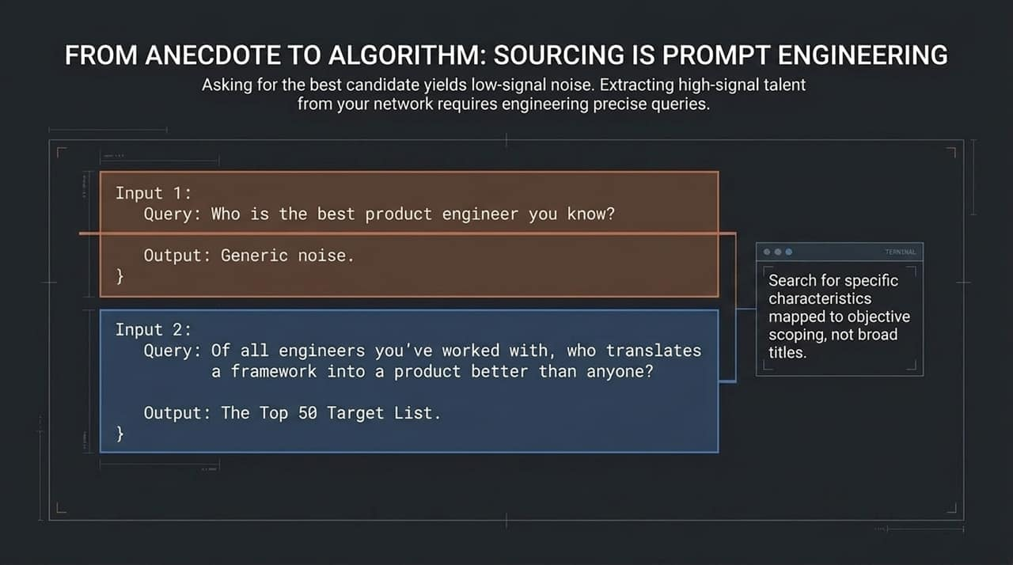
Notes:
Concept: Sourcing talent from your network or team is fundamentally an exercise in prompt engineering. Low-quality inputs yield low-signal noise.
The Bad Query (Input 1): If you ask a team member or contact: "Who is the best product engineer you know?", you'll get generic responses based on recency bias or likability.
The High-Signal Query (Input 2): Instead, ask a targeted question: "Of all engineers you've worked with, who translates a framework into a product better than anyone?"
The Result: By querying for specific, observable behaviors and characteristics mapped to objective scoping, you unlock a precise Top 50 target list instead of a list of popular peers.

Slide 6
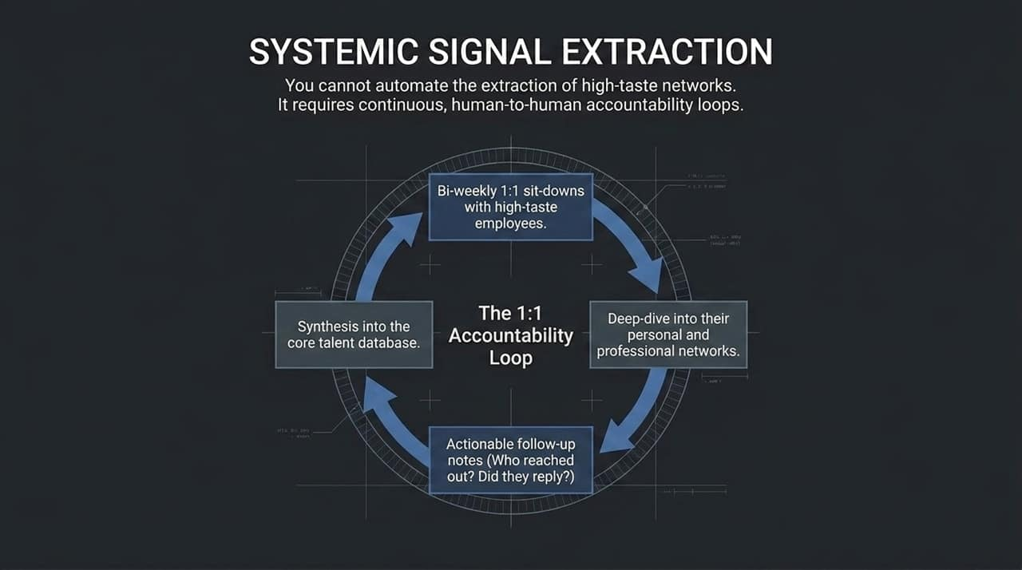
Notes:
The Core Reality: You cannot automate the extraction of high-taste networks. High-signal sourcing requires continuous, human-to-human accountability loops.
The 1:1 Accountability Loop:
Bi-weekly sit-downs: Regular structured meetings with high-taste employees inside your company.
Deep dive into networks: Systematically review their personal and professional connections.
Actionable follow-up notes: Track outreach metrics rigorously—who was contacted, who replied, and what next steps were taken.
Synthesis: Feed high-signal candidate data back into the core talent database.
Key Takeaway: Network extraction isn't a one-time referral blast; it is an ongoing, operationalized system.

Slide 7
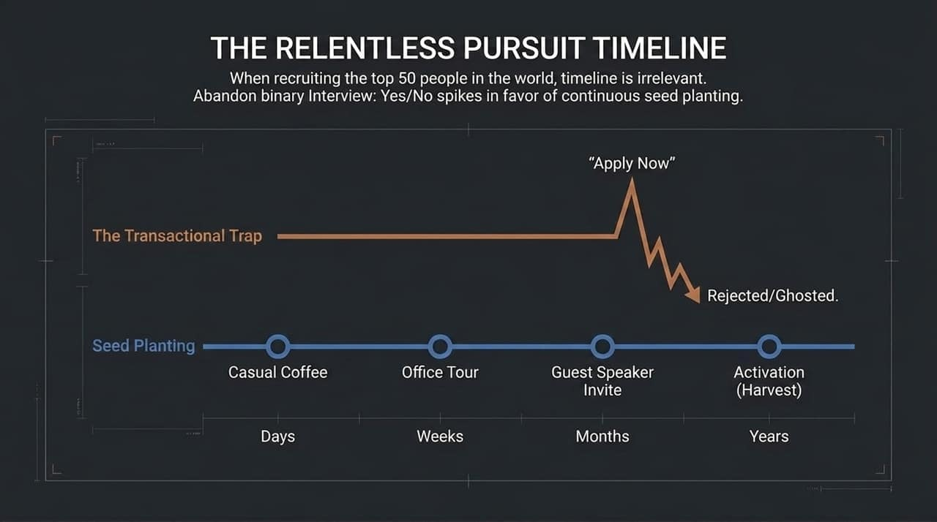
Notes:
The Transactional Trap: Traditional hiring assumes a candidate's journey is linear: see a job post, click "Apply Now," go through interviews, and get an offer or get ghosted. When hiring world-class talent, this binary timeline is irrelevant.
Continuous Seed Planting: Sourcing the top 50 engineers in the world takes time, patience, and persistent relationship building:
Days: Casual coffee or low-pressure introduction.
Weeks: An informal tour of the office or engineering setup.
Months: Invitation to be a guest speaker or attend an internal tech sync.
Years: Activation (Harvest) when the timing aligns perfectly for the candidate.
Key Takeaway: Shift from transactional, immediate-need hiring to a long-term strategy of planting seeds and nurturing elite talent pipelines continuously.

Slide 8
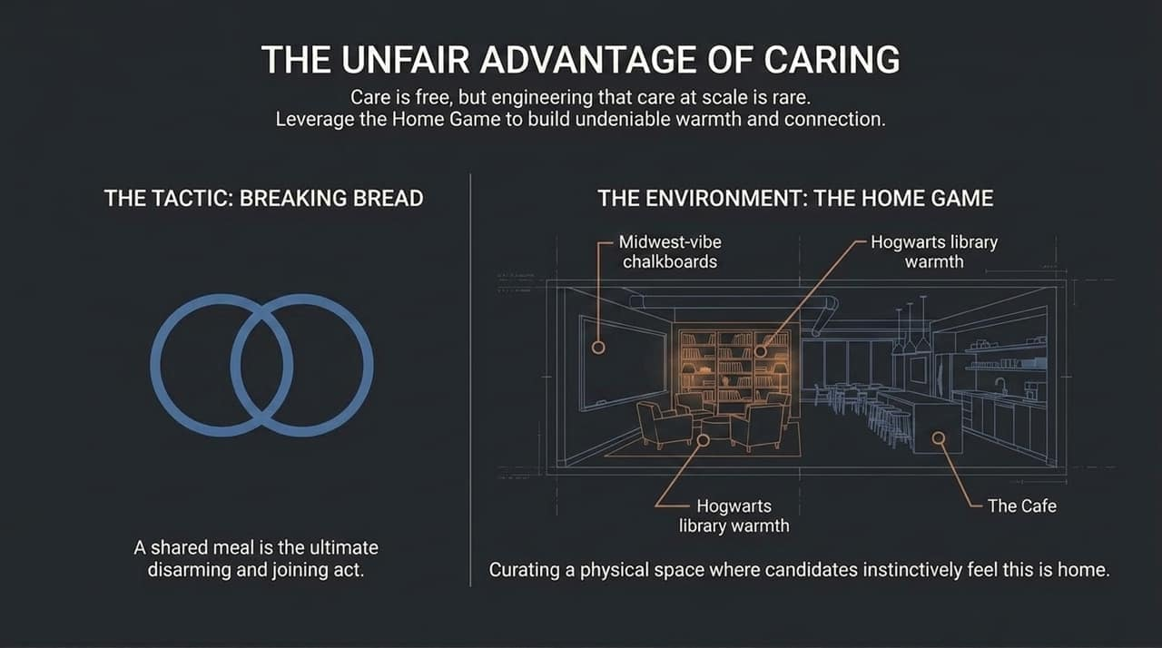
Notes:
Concept: Showing genuine care costs nothing, but operationalizing and engineering that care at scale is extremely rare—and highly effective.
The Tactic — Breaking Bread: Shared meals create a relaxed setting that strips away candidate defensiveness and creates genuine connection.
The Environment — The Home Game: Curating a physical space where candidates feel comfortable and welcomed. Examples include comfortable library-like environments, warm aesthetic details (like chalkboards), and welcoming cafe setups.
Key Takeaway: When candidates enter an environment designed with genuine warmth and care, candidate conversion rates increase dramatically.

Slide 9
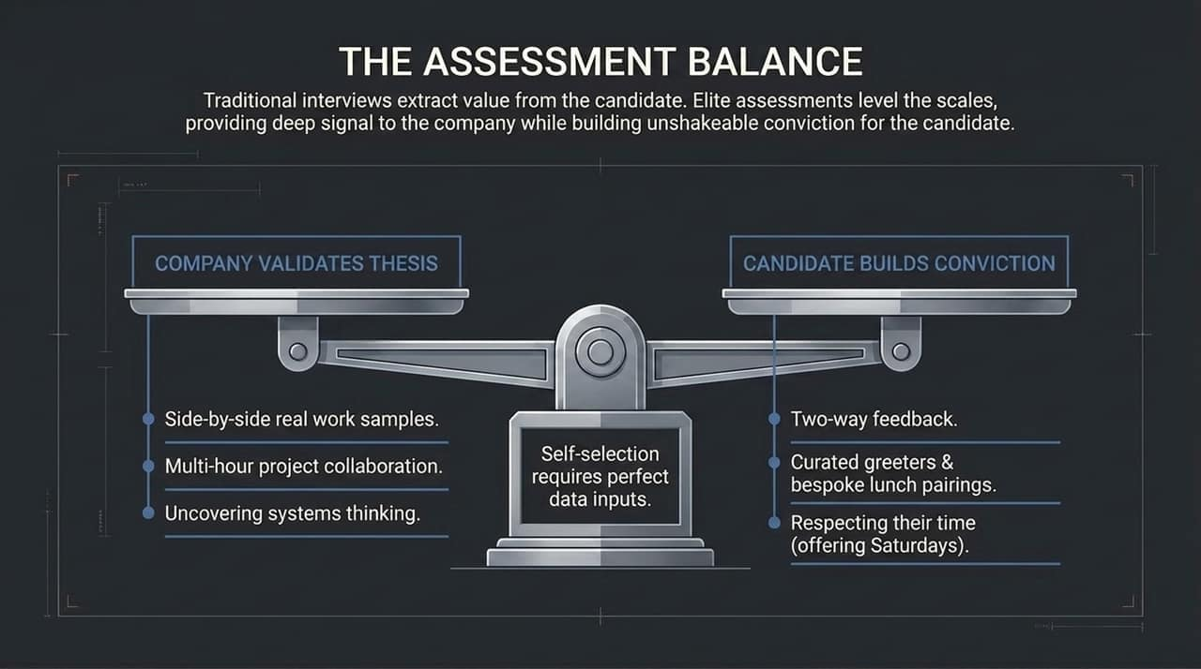
Notes:
The Flaw of Traditional Interviews: Conventional interviews extract value primarily for the company while giving the candidate a poor, one-sided experience.
Balancing the Scales: Elite assessments create mutual value:
For the Company: Uses side-by-side real work samples, multi-hour project collaborations, and deep probes into systems thinking to validate technical skill.
For the Candidate: Offers two-way feedback, curated greeters, bespoke pairings, and respect for their time (such as offering flexible weekend assessment slots).
Key Takeaway: High self-selection requires high-fidelity data on both sides. Candidates should leave the assessment with absolute conviction that this is the team they want to join.

Slide 10
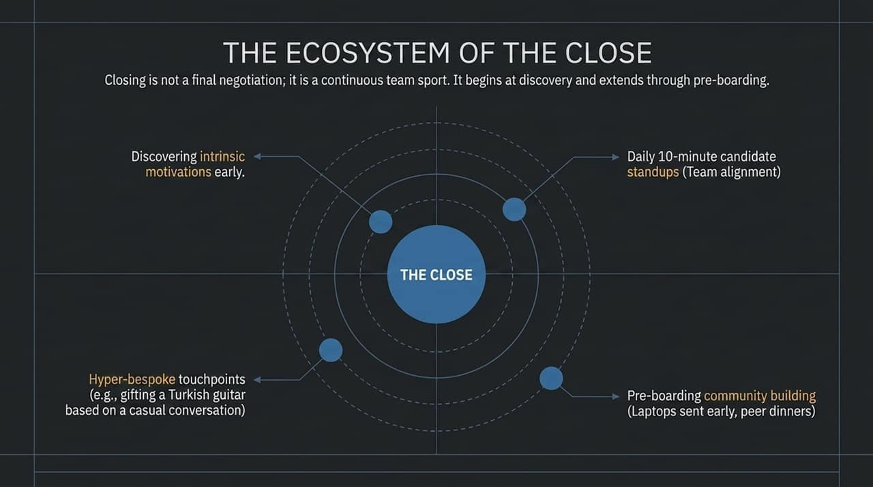
Notes:
Redefining Closing: Closing is not a single salary negotiation at the end of a process. It is a continuous, team-driven effort that starts at discovery and extends well past offer acceptance.
4 Pillars of an Effective Close:
Discover Intrinsic Motivations Early: Uncover what actually drives the candidate beyond basic compensation.
Daily 10-Minute Standups: Maintain internal alignment on candidate status and concerns.
Hyper-Bespoke Touchpoints: Demonstrate active listening (e.g., gifting a unique personal item mentioned in casual conversation).
Pre-Boarding Community Building: Send equipment early and invite hires to team dinners prior to day one to build belonging.

Slide 11
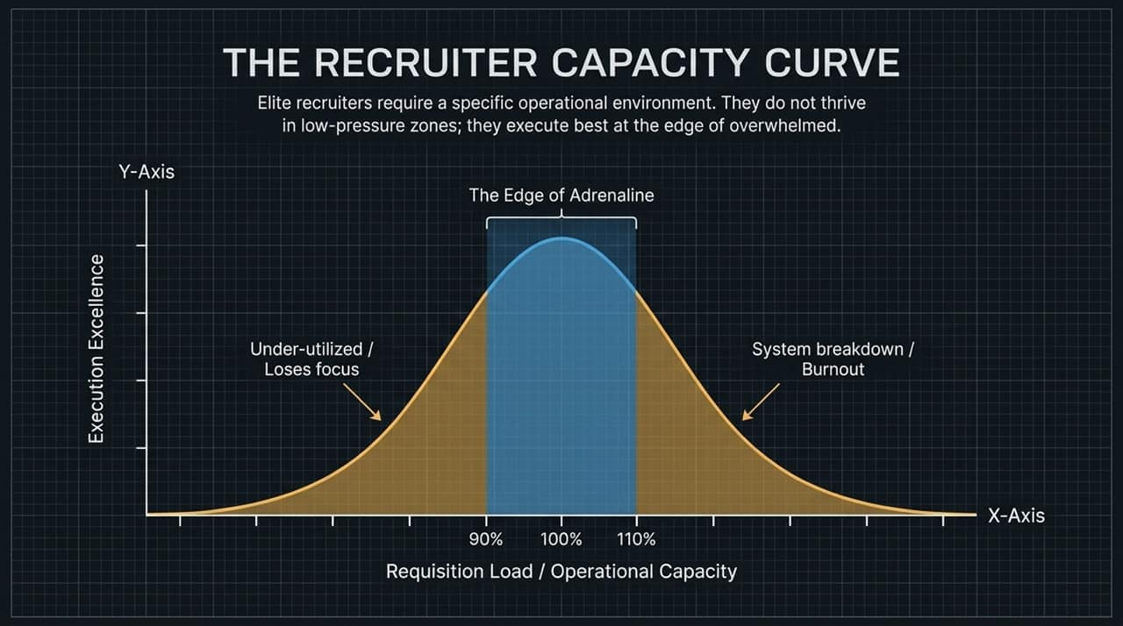
Notes:
Understanding Recruiter Operating Limits: Elite recruiters operate best within a specific operational capacity band.
The Curve Dynamics:
Under-utilized (<90% Capacity): Recruiters lose focus and momentum in low-pressure settings.
System Breakdown (>110% Capacity): Overloading recruiters leads to burnout, dropped details, and poor candidate experiences.
The Sweet Spot (90%–110%): "The Edge of Adrenaline"—where recruiters execute with maximum focus, speed, and precision.
Key Takeaway: Manage recruiter bandwidth carefully to keep performance optimized in the high-execution zone without driving burnout.

Slide 12
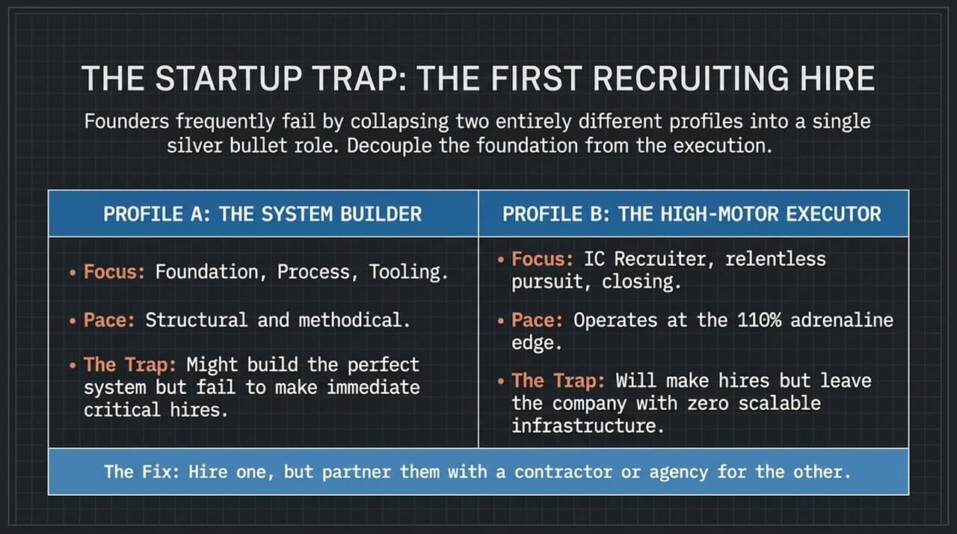
Notes:
The Common Mistake: Founders often attempt to hire a single "silver bullet" recruiter who can do everything, mixing two fundamentally distinct profiles:
Profile A — The System Builder: Focuses on foundation, processes, and tooling. The Trap: They might build great infrastructure, but struggle to close critical, immediate hires.
Profile B — The High-Motor Executor: Focuses on relentless hunting, outreach, and closing. The Trap: They make immediate hires, but leave no scalable recruiting infrastructure behind.
The Solution: Choose one primary profile for your first internal hire, and pair them with external contractors or agencies to handle the complementary function.

Slide 13
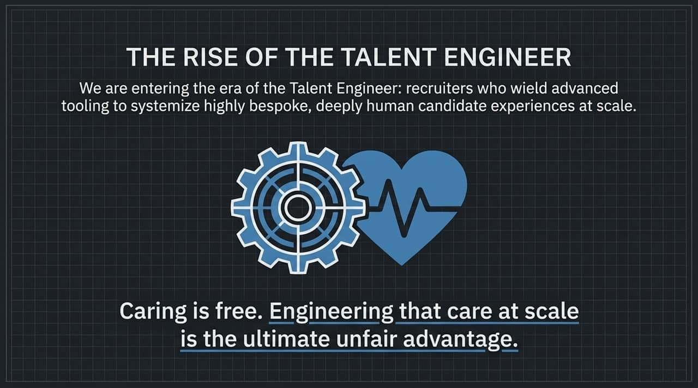
Notes:
The New Role — The Talent Engineer: We are entering an era where talent professionals combine system automation with high-touch human care.
Summary Comparison (Funnel of Doom vs. Pillar of Excellence):
Focus: Shift from volume and pass-through rates to identifying and engaging the Top 1%.
Accountability: Shift from talent acquisition owning the goal in isolation to the hiring manager owning the ultimate hiring decision.
Strategy: Move from broad sourcing nets to relentless, highly targeted outreach.
Core Concepts to Remember:
The 20% Response Trap: Reaching 100 people to get 20 responses measures availability, not excellence.
The Sales Fallacy: Candidates are complex human partners, not linear sales widgets.
Work Trials: Practical work samples remain the single strongest predictor of mutual success.
Closing Remark: Caring is free. Engineering that care at scale across your talent engine is the ultimate competitive advantage.

Slide 14
